Slide 1

Project 4 Price prediction for the ACT property market
Alistair Nguyen
Joshua Tean
Neha Sharma

Slide 2


ACT Property Market
Topic one - Introduction
Topic two – Model - 1
Topic three – Model -2
Topic four - Limitations.

Slide 3


Introduction
For our project- 04 we went with the real estate market. After dwelling into the data set from all over Australia over the last three years we decided to put our focus on ACT.
This year has seen Canberra’s property market take a tumble from the pandemic price peak; however, dwellings remain $320,000 more expensive on average than before the global pandemic hit in 2020.
Domain’s End of Year Wrap for 2022 revealed median prices were up in Canberra 41.2 per cent than the pandemic trough despite a six per cent median dwelling price decrease since the peak earlier this year.

Slide 4
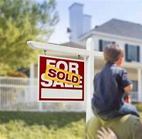
Purpose of the project
The whole idea behind the project model is to try to use the historical data and train a model in a way that it can predict current values if someone were to buy property today.
We are aware that factors like price can be dependent on n number of features.
However today we are focusing on what type of property you are trying to buy.

Slide 5

Assumptions
Even though we are trying to train the model closest to the perfect the important decision of one's maybe biggest investment in life can’t be based on a few factors. Hence, we would like to clarify a few assumptions about the project.
1) No pandemic- This model is not designed with the consideration of the pandemic.
2) No first home buyer boom- we have not added a consideration for the government supports for the first home buyers.
3) No banks - Interest rates, tax savings and ease of lending these factors are not considered in the model.

Slide 6
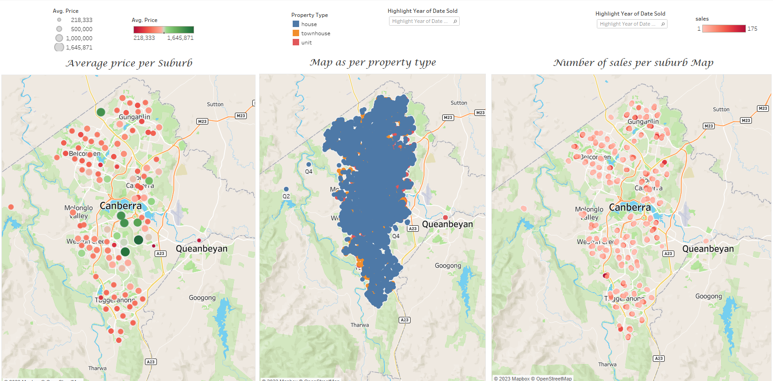

Slide 7



Topic Two
Subtitle

Slide 8
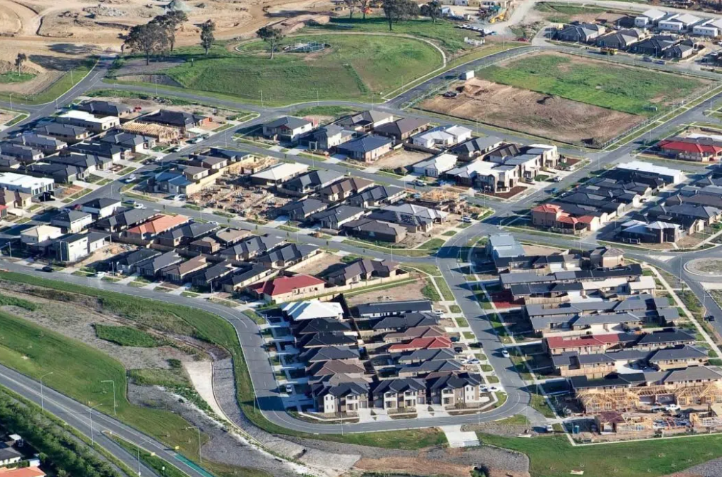
Data Collection
Data extraction
Data Modeling Implementation
Raw data obtained from https://www.kaggle.com/datasets/suryajadahake/australia-property-sales
Pandas used to clean data
All null values and states outside of ACT removed
Three test were conducted across Houses, Townhouse and Units
Narrowed down to Price bedroom and postcode
Logistic Regression and Random Forest Classifier
R-squared testing

Slide 9
Data Modeling Implementation
 | Logistic Regression | Category 2 | Random Forest Classifier | Category 4
 | Training Data Score | Testing Data Score | Training Data Score | Testing Data Score
House | 0.9262910 | 0.9347417 | 0.99217527 | 0.9098591
Townhouse | 0.8769544 | 0.8900203 | 0.9347382 | 0.8431771
Unit | 0.9478295 | 0.9414575 | 0.9621664 | 0.9247311

Slide 10
Data Modeling Implementation
Property Type | R-squared value
House | 0.3646825
Townhouse | 0.4428827
Unit | 0.3359805

Slide 11

Output
Potential data inclusion
House and Land size
Bathrooms
Car space
Quality of the dwelling
Infrastructures proximity

Slide 15

The way to get started is to quit talking and begin doing.
Walt Disney

Slide 16
CHART

Slide 17




team
Name
Name
Name
Name
Title
Title
Title
Title

Slide 18
TIMELINE
Title
To start a presentation, go to the Slide Show tab, and select From Beginning.
Title
To start a presentation, go to the Slide Show tab, and select From Beginning.
Title
During your presentation, the speaker notes are visible on your monitor, but aren't visible to the audience.
Title
Title
The Notes pane is a box that appears below each slide. Tap it to add notes.
If you don’t see the Notes pane or it is completely minimized, click Notes on the task bar across the bottom of the PowerPoint window.

Slide 19
Content
Summary
SUMMARY
Add text, images, art, and videos.
Add transitions, animations, and motion.
Save to OneDrive, to get to your presentations from your computer, tablet, or phone.
Open the Design Ideas pane for instant slide makeovers.
When we have design ideas, we’ll show them to you right there.

Slide 20
Content 2
Summary
summary
summary
Add text, images, art, and videos.
Add transitions, animations, and motion.
Save to OneDrive, to get to your presentations from your computer, tablet, or phone.
Open the Design Ideas pane for instant slide makeovers.
When we have design ideas, we’ll show them to you right there.
This PowerPoint theme uses its own unique set of colors, fonts, and effects to create the overall look and feel of these slides.
PowerPoint has tons of themes to give your presentation just the right personality.

Slide 21




Summary
With PowerPoint, you can create presentations and share your work with others, wherever they are. Type the text you want here to get started. You can also add images, art, and videos on this template. Save to OneDrive and access your presentations from your computer, tablet, or phone.

Slide 22

Thank you
Presenter Name
Email Address
Website Address

